Slide 1
Parity Generator & Parity Checker

Slide 2
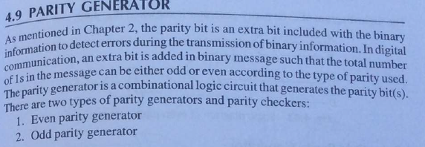
Parity Generator
Reference: Digital Electronics by G. K. Kharate

Slide 3
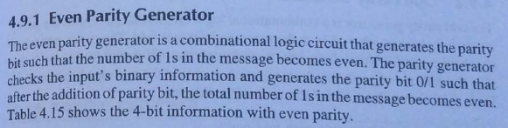
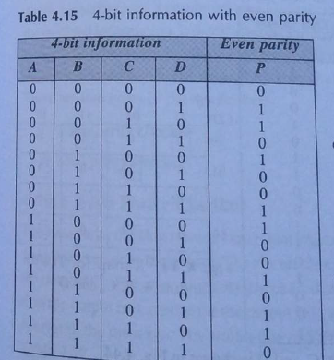
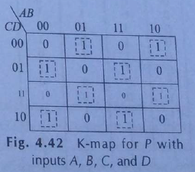
Reference: Digital Electronics by G. K. Kharate

Slide 4
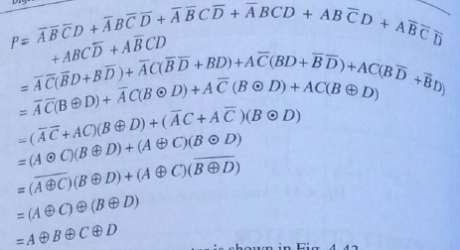
Even Parity Generator
Reference: Digital Electronics by G. K. Kharate

Slide 5
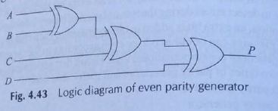
Even Parity Generator
Reference: Digital Electronics by G. K. Kharate

Slide 6
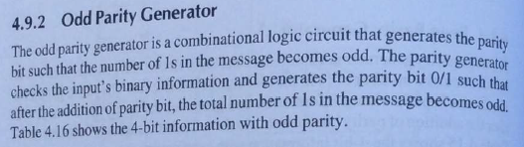
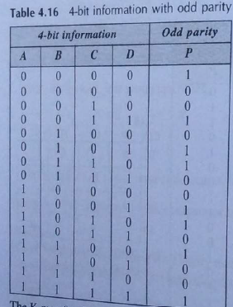
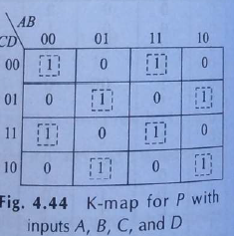
Reference: Digital Electronics by G. K. Kharate

Slide 7
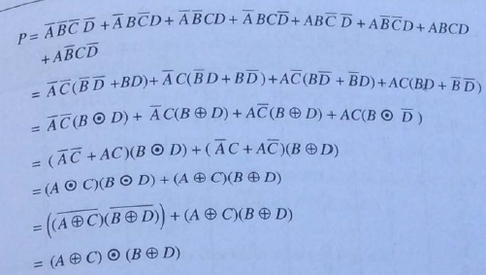
Odd Parity Generator
Reference: Digital Electronics by G. K. Kharate

Slide 8
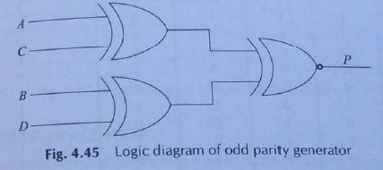
Odd Parity Generator
Reference: Digital Electronics by G. K. Kharate

Slide 9
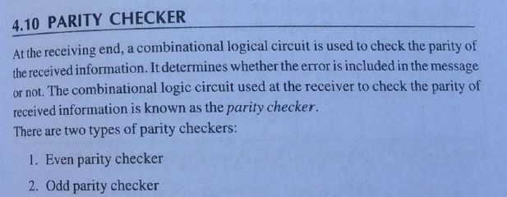

Slide 10
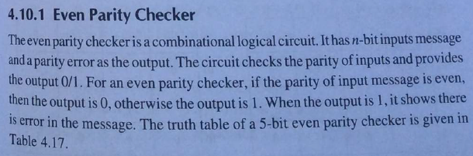
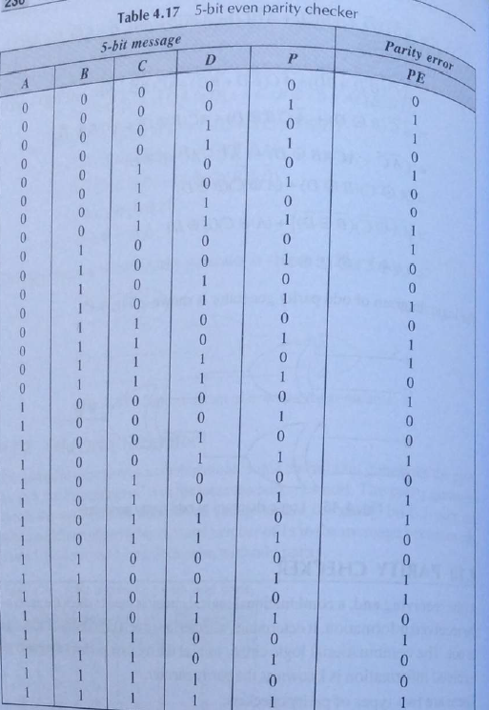
Reference: Digital Electronics by G. K. Kharate

Slide 11
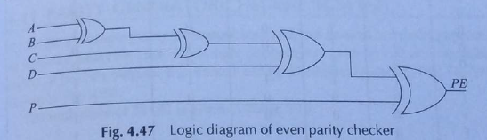
Even Parity Checker
Reference: Digital Electronics by G. K. Kharate

Slide 12
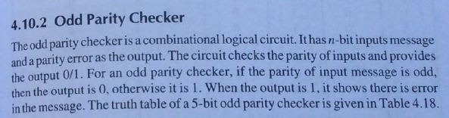
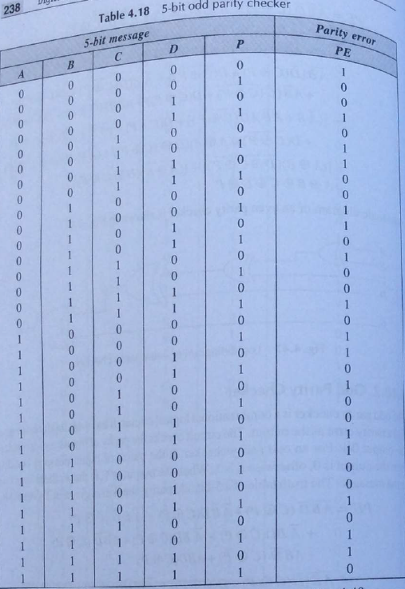
Reference: Digital Electronics by G. K. Kharate

Slide 13
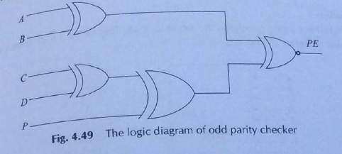
Odd Parity Checker
Reference: Digital Electronics by G. K. Kharate

